Slide 1
Chapter-5
Project Management

Slide 2
Topics covered
Risk management
Managing people
Teamwork

Slide 3
Software project management
Concerned with activities involved in ensuring that software is delivered on time and on schedule and in accordance with the requirements of the organisations developing and procuring the software.
Project management is needed because software development is always subject to budget and schedule constraints that are set by the organisation developing the software.
The project manager’s job is to ensure that the software project meets and overcomes these constraints as well as delivering high-quality software.

Slide 4
Success criteria
Deliver the software to the customer at the agreed time.
Keep overall costs within budget.
Deliver software that meets the customer’s expectations.
Maintain a happy and well-functioning development team.

Slide 5
Software management distinctions
The product is intangible.
Software cannot be seen or touched. Software project managers cannot see progress by simply looking at the artifact that is being constructed.
Many software projects are 'one-off' projects.
Large software projects are usually different in some ways from previous projects. Even managers who have lots of previous experience may find it difficult to anticipate problems.
Software processes are variable and organization specific.
We still cannot reliably predict when a particular software process is likely to lead to development problems.

Slide 6
Management activities
Project planning
Project managers are responsible for planning. estimating and scheduling project development and assigning people to tasks.
Reporting
Project managers are usually responsible for reporting on the progress of a project to customers and to the managers of the company developing the software.
Risk management
Project managers assess the risks that may affect a project, monitor
these risks and take action when problems arise.

Slide 7
Management activities
People management
Project managers have to choose people for their team and establish ways of working that leads to effective team performance
Proposal writing
The first stage in a software project may involve writing a proposal to win a contract to carry out an item of work. The proposal describes the objectives of the project and how it will be carried out.

Slide 8
Risk management
Risk management is concerned with identifying risks and
drawing up plans to minimise their effect on a project.
A risk is a probability that some adverse circumstance will occur
Project risks affect schedule or resources;
Product risks affect the quality or performance of the software being developed;
Business risks affect the organisation developing or procuring the software.

Slide 9
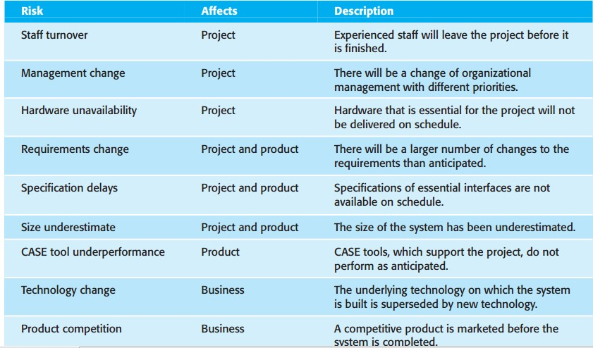
Examples of common project, product, and business risks

Slide 10
The risk management process
Risk identification
Identify project, product and business risks;
Risk analysis
Assess the likelihood and consequences of these risks;
Risk planning
Draw up plans to avoid or minimise the effects of the risk;
Risk monitoring
Monitor the risks throughout the project;

Slide 11
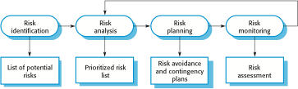
The risk management process

Slide 12
Risk identification
May be a team activities or based on the individual project
manager’s experience.
A checklist of common risks may be used to identify risks in a project
Technology risks.
People risks.
Organisational risks.
Requirements risks.
Estimation risks.

Slide 13
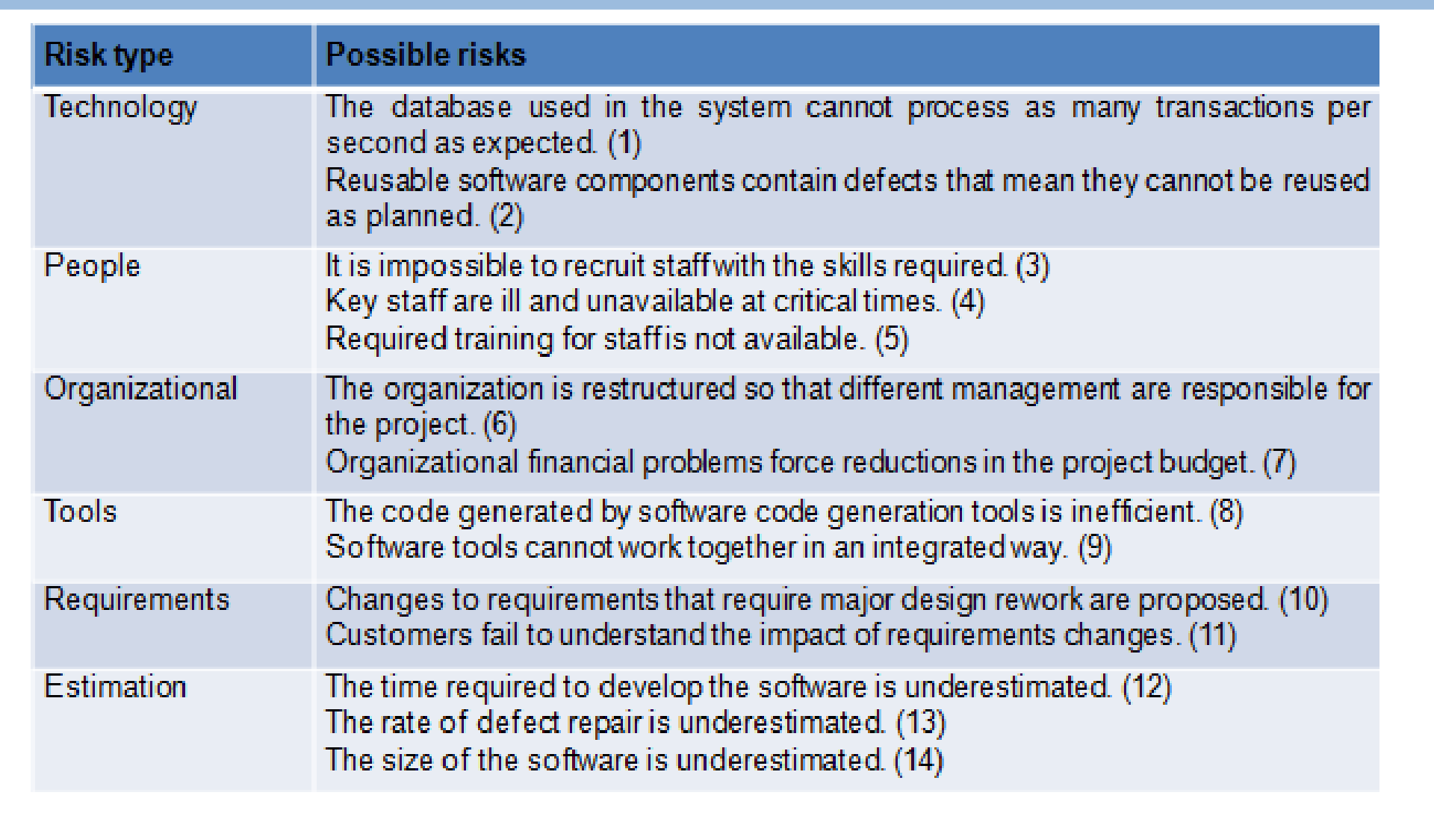
Examples of different risk types

Slide 14
Risk analysis
Assess probability and seriousness of each risk.
Probability may be very low, low, moderate, high or very high.
Risk consequences might be catastrophic, serious, tolerable or insignificant.

Slide 15
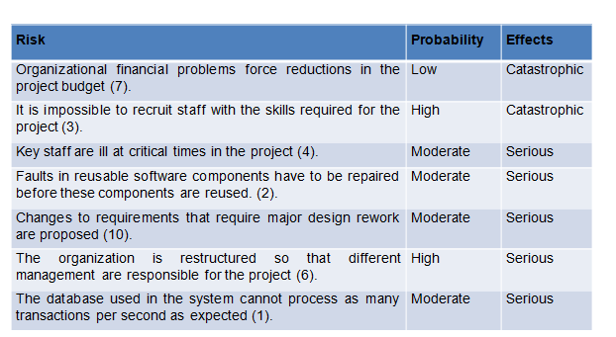
Risk types and examples

Slide 16
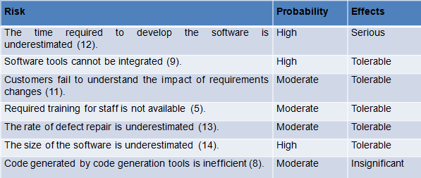
Risk types and examples

Slide 17
Risk planning
Consider each risk and develop a strategy to manage that risk.
Avoidance strategies
The probability that the risk will arise is reduced;
Minimisation strategies
The impact of the risk on the project or product will be reduced;
Contingency plans
If the risk arises, contingency plans are plans to deal with that risk;

Slide 18
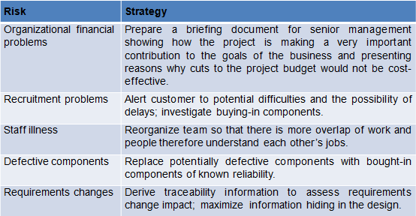
Strategies to help manage risk

Slide 19
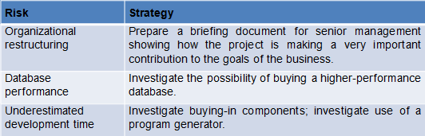
Strategies to help manage risk

Slide 20
Risk monitoring
Assess each identified risks regularly to decide whether or not
it is becoming less or more probable.
Also assess whether the effects of the risk have changed.
Each key risk should be discussed at management progress meetings.

Slide 21
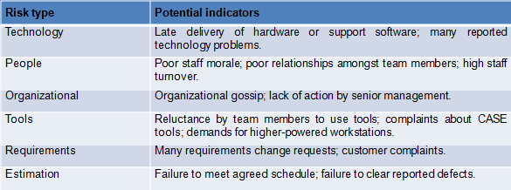
Risk indicators

Slide 22
Managing people
People are an organisation’s most important assets.
The tasks of a manager are essentially people-oriented. Unless there is some understanding of people, management will be unsuccessful.
Poor people management is an important contributor to
project failure.

Slide 23
People management factors
Consistency
Team members should all be treated in a comparable way without favourites or discrimination.
Respect
Different team members have different skills and these differences
should be respected.
Inclusion
Involve all team members and make sure that people’s views are considered.
Honesty
You should always be honest about what is going well and what is going badly in a project.

Slide 24
Motivating people
An important role of a manager is to motivate the people
working on a project.
Motivation means organizing the work and the working environment to encourage people to work effectively.
If people are not motivated, they will not be interested in the work they are doing. They will work slowly, be more likely to make mistakes and will not contribute to the broader goals of the team or the organization.
Motivation is a complex issue but it appears that their are different types of motivation based on:
Basic needs (e.g. food, sleep, etc.);
Personal needs (e.g. respect, self-esteem);
Social needs (e.g. to be accepted as part of a group).

Slide 25
Need satisfaction
In software development groups, basic physiological and
safety needs are not an issue.
Social
Provide communal facilities;
Allow informal communications e.g. via social networking
Esteem
Recognition of achievements;
Appropriate rewards.
Self-realization
Training - people want to learn more;
Responsibility.

Slide 26
Individual motivation –CASE STUDY
Alice is a software project manager working in a company that develops alarm systems. This company wishes to enter the growing market of assistive technology to help elderly and disabled people live independently. Alice has been asked to lead a team of 6 developers than can develop new products based around the company’s alarm technology.
Alice’s assistive technology project starts well. Good working relationships develop within the team and creative new ideas are developed. The team decides to develop a peer-to-peer messaging system using digital televisions linked to the alarm network for communications.
However, some months into the project, Alice notices that Dorothy, a hardware design expert, starts coming into work late, the quality of her work deteriorates and, increasingly, that she does not appear to be communicating with other members of the team.

Slide 27
Individual motivation –CASE STUDY
Alice talks about the problem informally with other team members to try to find out if Dorothy’s personal circumstances have changed, and if this might be affecting her work. They don’t know of anything, so Alice decides to talk with Dorothy to try to understand the problem.
After some initial denials that there is a problem, Dorothy admits that she has lost interest in the job. She expected that she would be able to develop and use her hardware interfacing skills. However, because of the product direction that has been chosen, she has little opportunity for this. Basically, she is working as a C programmer with other team members.
Although she admits that the work is challenging, she is concerned that she is not developing her interfacing skills. She is worried that finding a job that involves hardware interfacing will be difficult after this project. Because she does not want to upset the team by revealing that she is thinking about the next project, she has decided that it is best to minimize conversation with them.

Slide 28
Personality types
Task-oriented.
The motivation for doing the work is the work itself;
Self-oriented.
The work is a means to an end which is the achievement of individual goals - e.g. to get rich, to play tennis, to travel etc.;
Interaction-oriented
The principal motivation is the presence and actions of co-workers. People go to work because they like to go to work.

Slide 29
Motivation balance
of each class.
The balance can change depending on personal circumstances and external events.
However, people are not just motivated by personal factors
but also by being part of a group and culture.
People go to work because they are motivated by the people that they work with.
Individual
motivations are made up of elements

Slide 30
Teamwork
Most software engineering is a group activity
The development schedule for most non-trivial software projects is such that they cannot be completed by one person working alone.
A good group is cohesive and has a team spirit. The people involved are motivated by the success of the group as well as by their own personal goals.
Group interaction is a key determinant of group performance.
Flexibility in group composition is limited
Managers must do the best they can with available people.

Slide 31
Group cohesiveness
In a cohesive group, members consider the group to be more
important than any individual in it.
The advantages of a cohesive group are:
Group quality standards can be developed by the group members.
Team members learn from each other and get to know each other’s
work; Inhibitions caused by ignorance are reduced.
Knowledge is shared. Continuity can be maintained if a group member leaves.
Refactoring and continual improvement is encouraged. Group members work collectively to deliver high quality results and fix problems, irrespective of the individuals who originally created the design or program.

Slide 32
Team spirit –CASE STUDY
Alice, an experienced project manager, understands the importance of creating a cohesive group. As they are developing a new product, she takes the opportunity of involving all group members in the product specification and design by getting them to discuss possible technology with elderly members of their families. She also encourages them to bring these family members to meet other members of the development group.
Alice also arranges monthly lunches for everyone in the group. These lunches are an opportunity for all team members to meet informally, talk around issues of concern, and get to know each other. At the lunch, Alice tells the group what she knows about organizational news, policies, strategies, and so forth. Each team member then briefly summarizes what they have been doing and the group discusses a general topic, such as new product ideas from elderly relatives.
.

Slide 33
Team spirit –CASE STUDY
Every few months, Alice organizes an ‘away day’ for the group where the team spends two days on ‘technology updating’. Each team member prepares an update on a relevant technology and presents it to the group. This is an off-site meeting in a good hotel and plenty of time is scheduled for discussion and social interaction

Slide 34
The effectiveness of a team
The people in the group
You need a mix of people in a project group as software development involves diverse activities such as negotiating with clients, programming, testing and documentation.
The group organization
A group should be organized so that individuals can contribute to the
best of their abilities and tasks can be completed as expected.
Technical and managerial communications
Good communications between group members, and between the
software engineering team and other project stakeholders, is essential.

Slide 35
Selecting group members
A manager or team leader’s job is to create a cohesive group and organize their group so that they can work together effectively.
This involves creating a group with the right balance of technical skills and personalities, and organizing that group so that the members work together effectively.

Slide 36
Assembling a team
May not be possible to appoint the ideal people to work on a
project
Project budget may not allow for the use of highly-paid staff;
Staff with the appropriate experience may not be available;
An organisation may wish to develop employee skills on a
software project.
Managers have to work within these constraints especially when there are shortages of trained staff.

Slide 37
Group composition
Group composed of members who share the
same motivation can be problematic
Task-oriented - everyone wants to do their own thing;
Self-oriented - everyone wants to be the boss;
Interaction-oriented - too much chatting, not enough work.
An effective group has a balance of all types.
This can be difficult to achieve software engineers are often task-oriented.
Interaction-oriented people are very important as they can detect and defuse tensions that arise.

Slide 38
Group composition -CASE STUDY
In creating a group for assistive technology development, Alice is aware of the importance of selecting members with complementary personalities. When interviewing potential group members, she tried to assess whether they were task-oriented, self-oriented, or interaction-oriented. She felt that she was primarily a self-oriented type because she considered the project to be a way of getting noticed by senior management and possibly promoted.
She therefore looked for one or perhaps two interaction-oriented personalities, with task-oriented individuals to complete the team

Slide 39
Group composition- CASE STUDY
The final assessment that she arrived at was:
➢
➢
➢
➢
➢
➢
➢
Alice—self-oriented Brian—task-oriented Bob—task-oriented Carol—interaction-oriented Dorothy—self-oriented Ed—interaction-oriented Fred—task-oriented

Slide 40
Group organization
The way that a group is organized affects the decisions that are made by that group, the ways that information is exchanged and the interactions between the development group and external project stakeholders.
Key questions include:
Should the project manager be the technical leader of the group?
Who will be involved in making critical technical decisions, and how will these be made?
How will interactions with external stakeholders and senior company management be handled?
How can groups integrate people who are not co- located?
How can knowledge be shared across the group?

Slide 41
Group organization
Small software engineering groups are usually organised informally
without a rigid structure.
For large projects, there may be a hierarchical structure where different groups are responsible for different sub-projects.
Agile development is always based around an informal group on the principle that formal structure inhibits information exchange

Slide 42
Informal groups
The group acts as a whole and comes to a consensus on
decisions affecting the system.
The group leader serves as the external interface of the group but does not allocate specific work items.
Rather, work is discussed by the group as a whole and tasks are allocated according to ability and experience.
This approach is successful for groups where all members are experienced and competent.

Slide 43
Cohesive Group
Cohesive groups prioritize collective goals over individual interests under strong leadership, fostering loyalty and resilience to tackle challenges effectively:
The benefits of creating a cohesive group are:
The group can establish its own quality standards Because these standards are established by consensus, they are more likely to be observed than external standards imposed on the group.
Individuals learn from and support each other Group members learn by working together. Inhibitions caused by ignorance are minimized as mutual learning is encouraged.

Slide 44
Cohesive Group
Knowledge is shared Continuity can be maintained if a group member leaves. Others in the group can take over critical tasks and ensure that the project is not unduly disrupted.
Refactoring and continual improvement is encouraged Group members work collectively to deliver high-quality results and fix problems, irrespective of the individuals who originally created the design or program.

Slide 45
Group communications
Good communications are essential for effective group
working.
Information must be exchanged on the status of work, design decisions and changes to previous decisions.
Good communications also strengthens group cohesion as it
promotes understanding.

Slide 46
Group communications
Group size
The larger the group, the harder it is for people to communicate with other group members.
Group structure
Communication is better in informally structured groups than in
hierarchically structured groups.
Group composition
Communication is better when there are different personality types in a group and when groups are mixed rather than single sex.
The physical work environment
Good workplace organisation can help encourage communications.

